Slide 1
Support Vector Machines
Rezarta Islamaj Dogan
Resources
Support Vector Machines tutorial Andrew W. Moore
  www.autonlab.org/tutorials/svm.html
A tutorial on support vector machines for pattern recognition.
C.J.C. Burges.
    Data Mining and Knowledge Discovery, 2(2):955- 974, 1998.

Slide 2
Linear Classifiers
α
f
f(x,w,b) = sign(w x + b)
x
_{y}est
Linear Classifiers
w x + b>0
w x + b=0
How to classify this data?
denotes +1
denotes -1
w x + b<0

Slide 3
Linear Classifiers
w x + b>0
denotes +1
denotes -1
w x + b<0
Linear Classifiers
w x + b>0
denotes +1
denotes -1
w x + b<0

Slide 4
Linear Classifiers
w x + b>0
denotes +1
denotes -1
w x + b<0
Linear Classifiers
denotes +1
denotes -1
Misclassified to +1 class

Slide 5
Classifier Margin
denotes +1
denotes -1
Margin:
the width that the boundary could be increased by before hitting a datapoint.
Maximum Margin Classifier
Support Vectors are those datapoints that the margin pushes up against
Maximizing the margin is good
Implies that only support vectors are important; other training examples are ignorable.
Empirically it works very very well.

Slide 6

Finding the boundary
“Predict Class = +1”
_{x}+
M=Margin Width
zone
_{X}-
wx+b=1
“Predict Class = -1”
wx+b=0
zone
wx+b=-1
What we know:
w . x⁺ + b = +1
w . x⁻ + b = -1
w . (x⁺-x⁻⁾ = 2
M =
(x⁺ − x⁻ ) ⋅ w 2
w
= _{w}
Learning the Maximum Margin Classifier
Given a guess for w and b
Compute whether all data points in correct half- planes
Compute the width of the margin
Search the space of w’s and b’s to find the widest margin that matches all data points
- Quadratic programming

Slide 7
Linear SVM
Correctly classify all training data
wx_{i} + b ! 1 if y_{i} = +1
if y_{i} = -1
wx_{i} + b ! 1
y_{i} (wx_{i} + b) ! 1
for all i
Maximize: M = ²
1
Minimize: w^{t} w
2
w
Solving the Optimization Problem
Need to optimize a quadratic function subject to linear
constraints.
Quadratic optimization problems are a well-known class of mathematical programming problems.
The solution involves constructing a dual problem where a Lagrange multiplier is associated with every constraint in the primary problem.
Find w and b such that
Φ(w) =½ w^{T}w is minimized;
and for all {(x_{i} ,y_{i})}: y_{i} (w^{T}x_{i} + b) ≥ 1

Slide 8
SVM
As margin increases generalization increases
The hyperplanes that passes through positive points (positive hyperplane)and negative points (negative hyperplane) are called support vectors.
Another intuition is getting a hyperplane through convex hulls

Slide 9
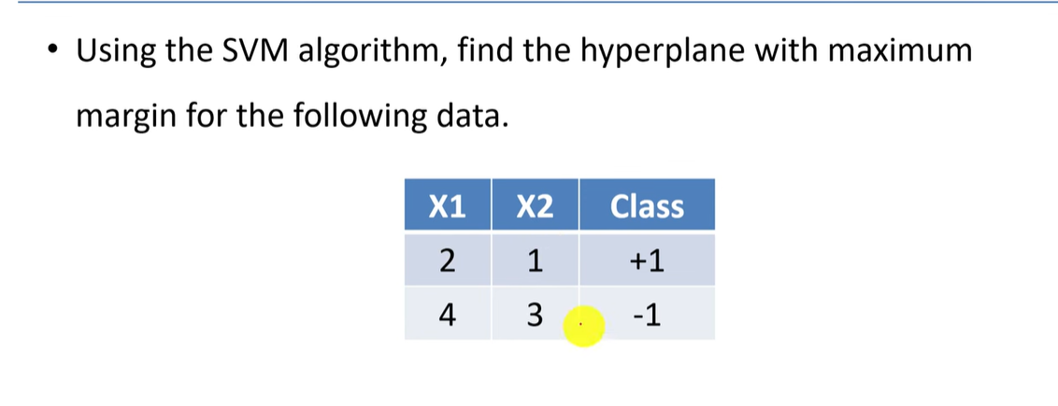

Slide 10
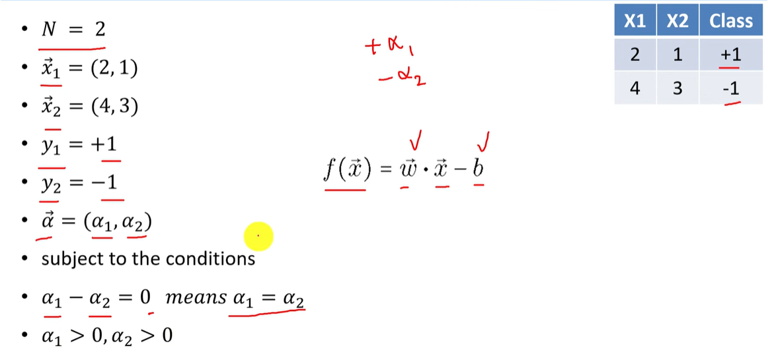

Slide 11
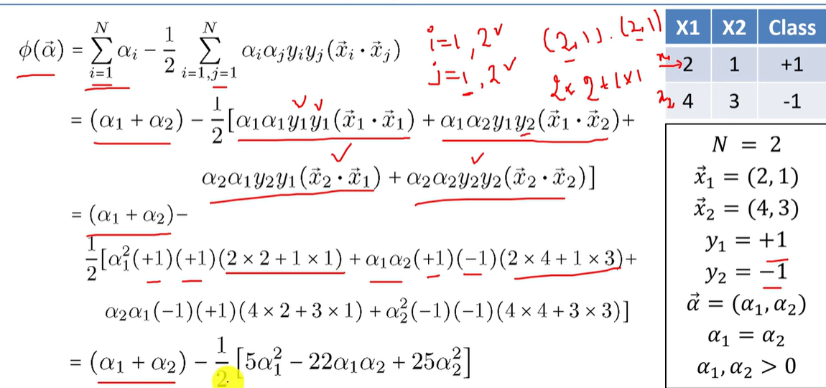

Slide 12
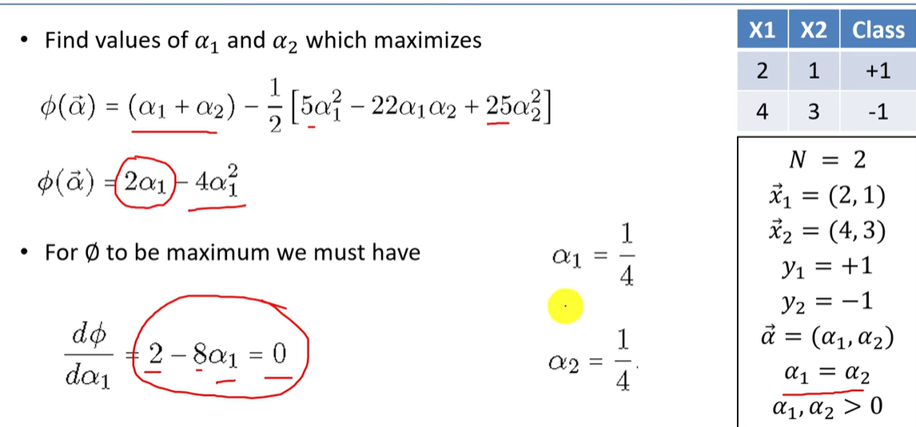

Slide 13
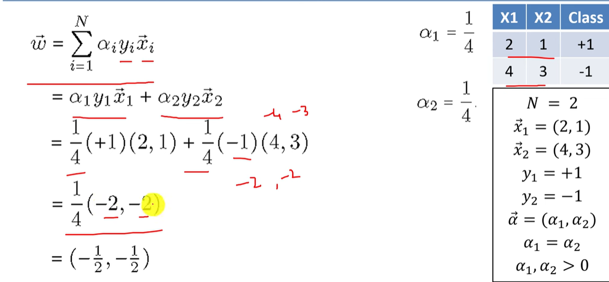

Slide 14
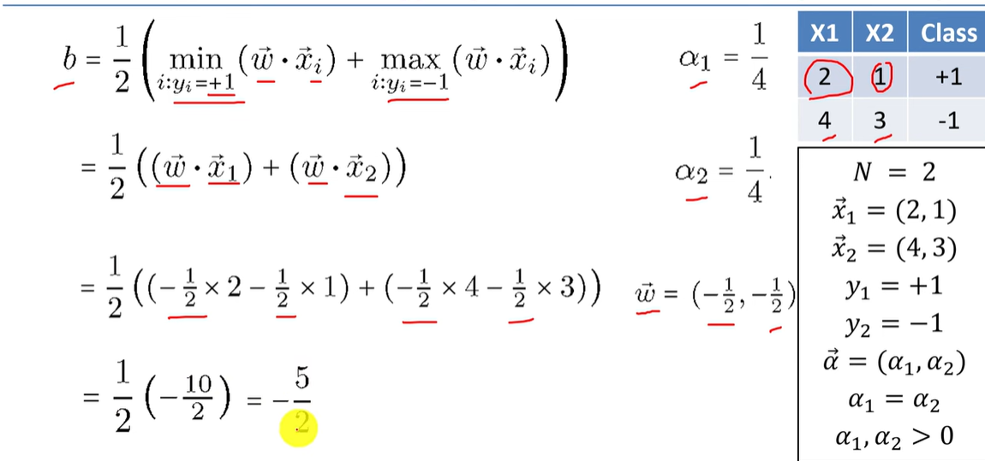

Slide 15
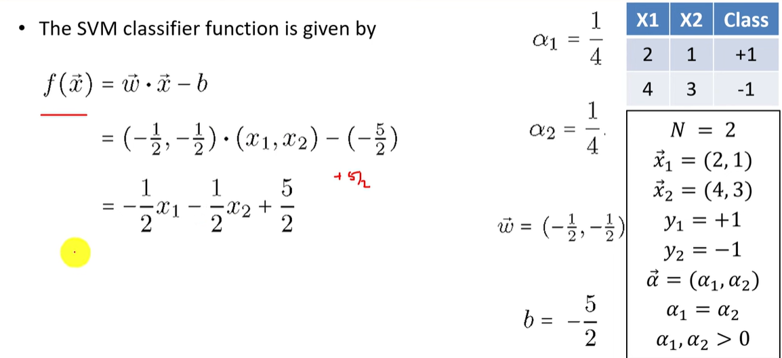

Slide 16
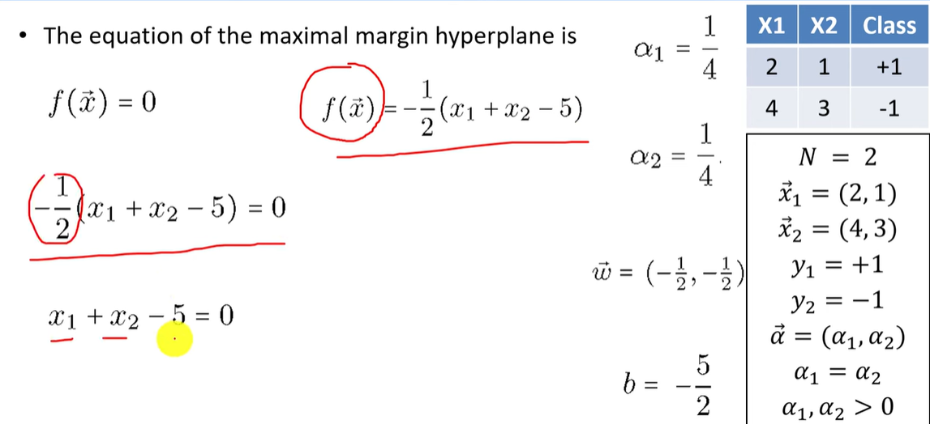

Slide 17
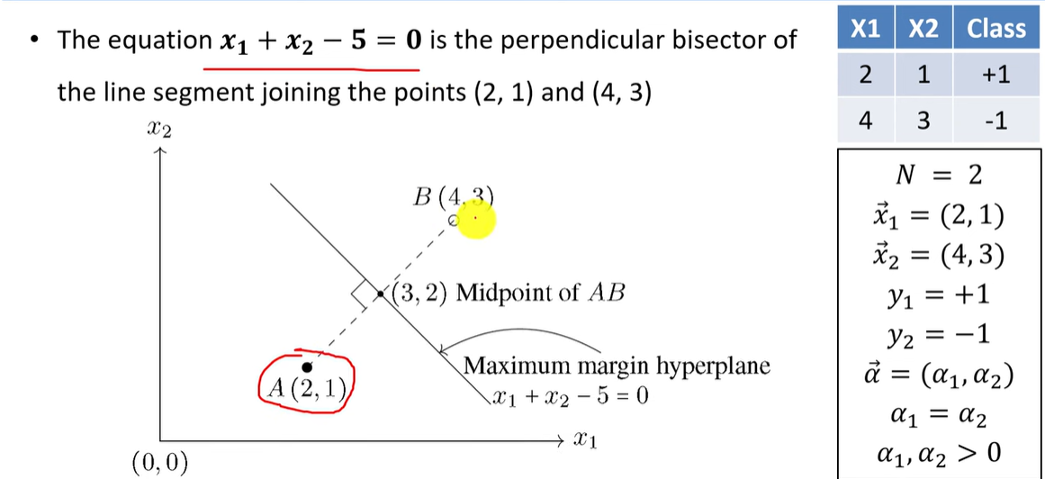

Slide 18
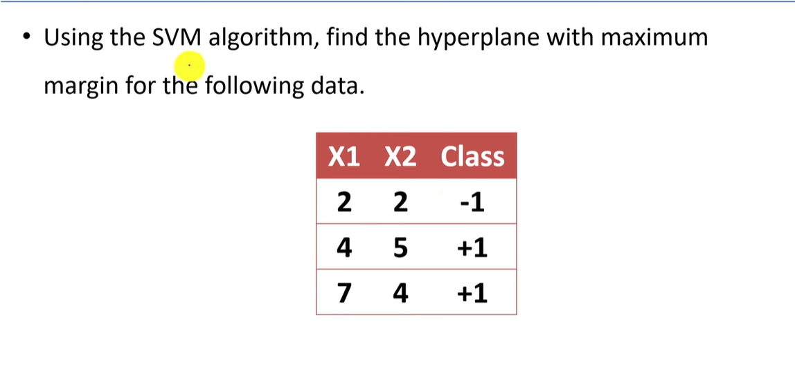

Slide 19
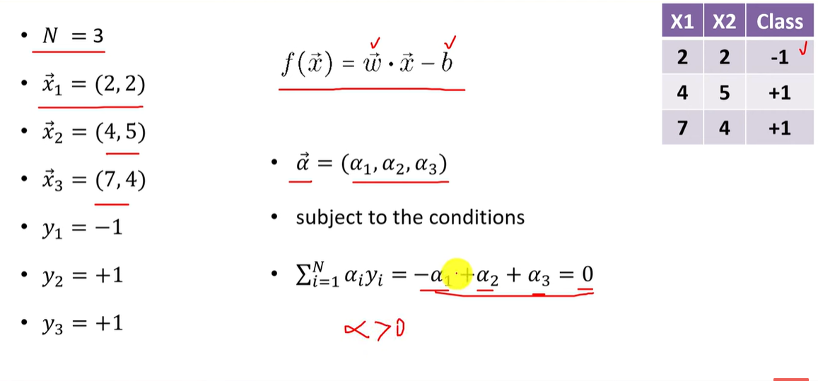

Slide 20
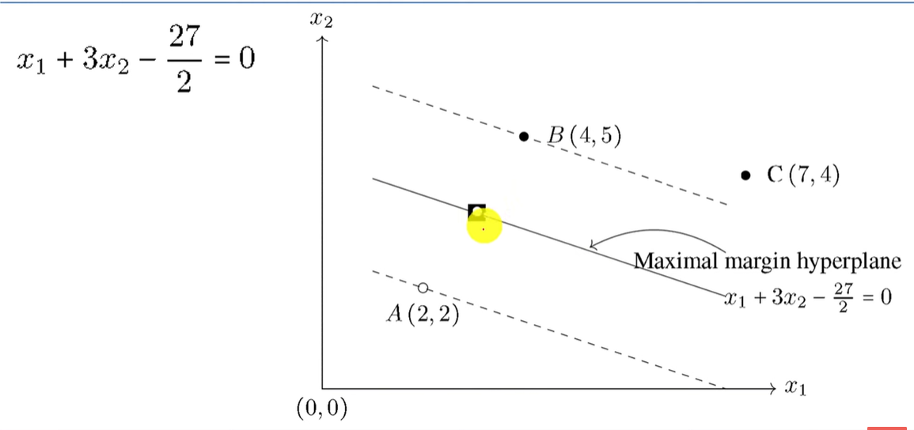

Slide 21
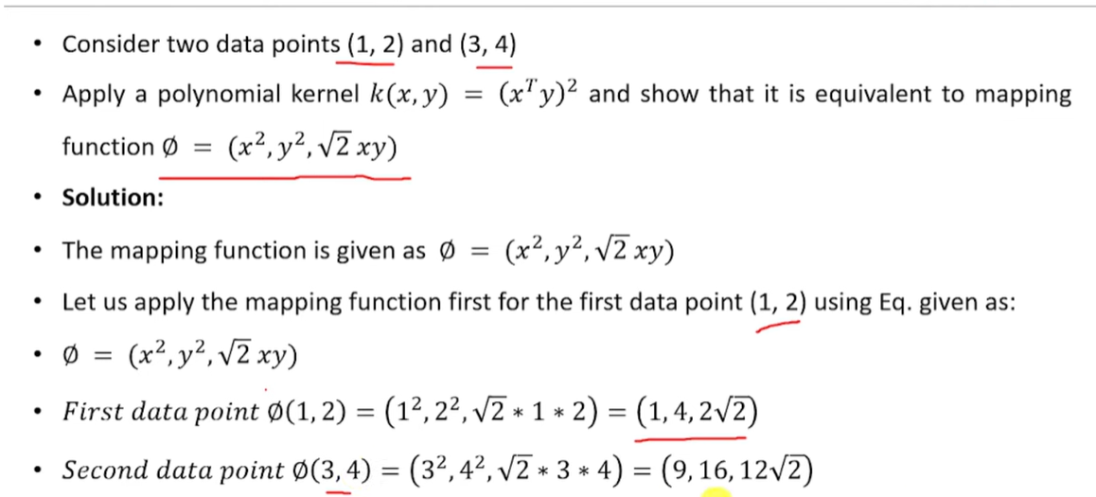

Slide 22
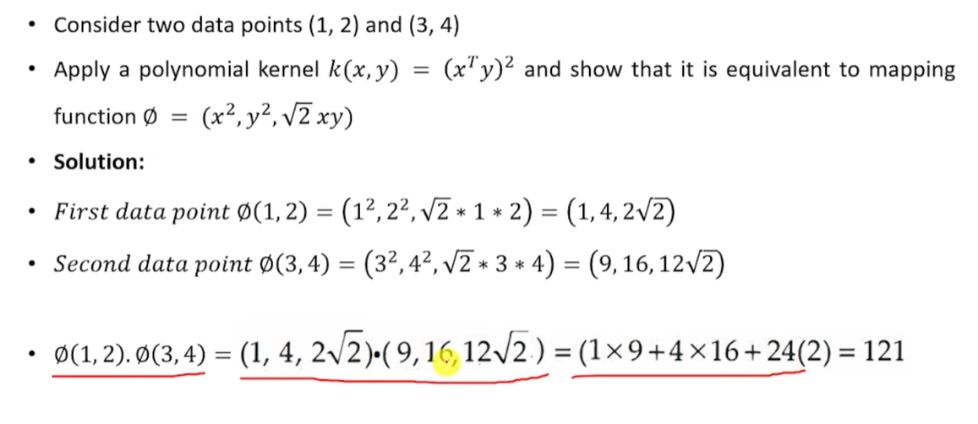

Slide 23
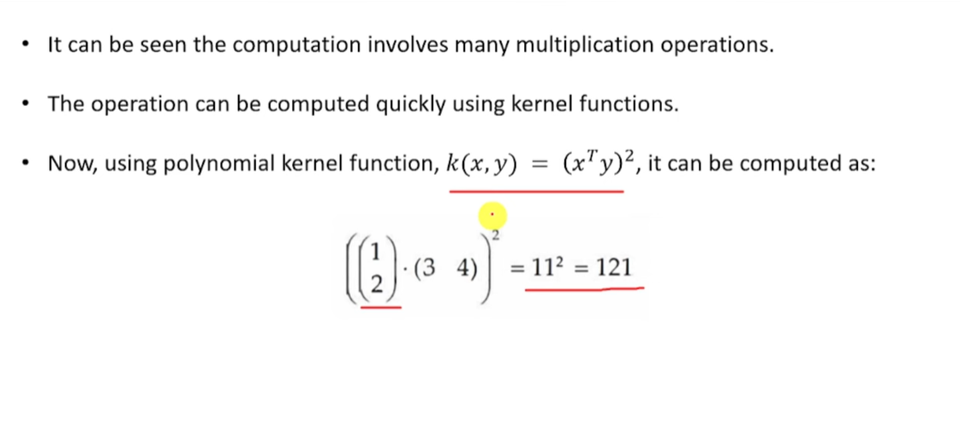

Slide 24
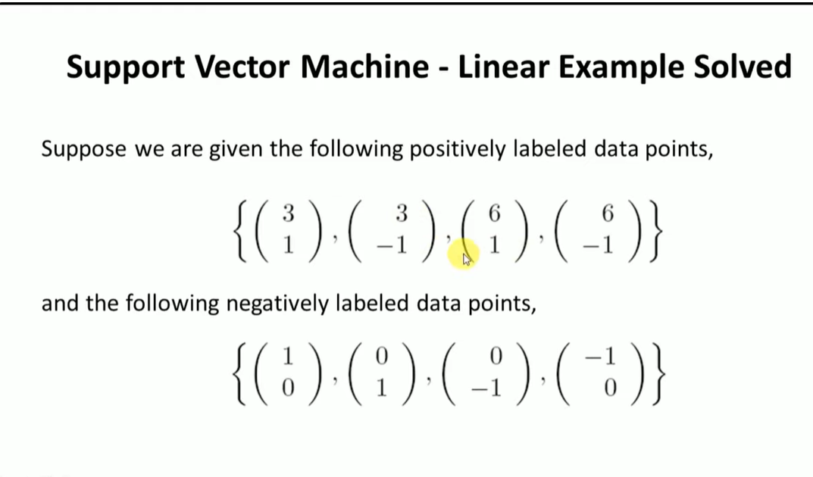

Slide 25
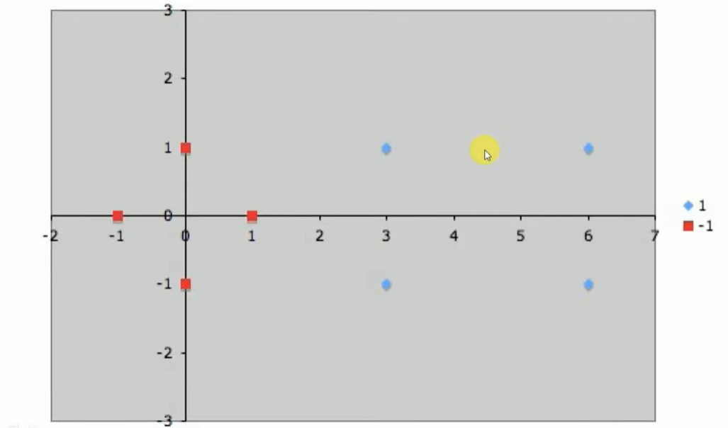

Slide 26
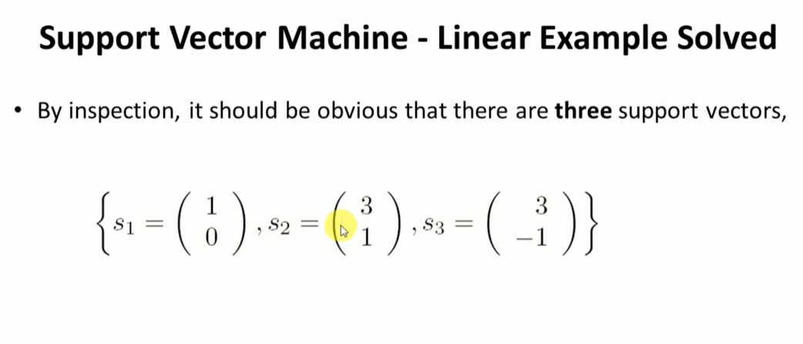
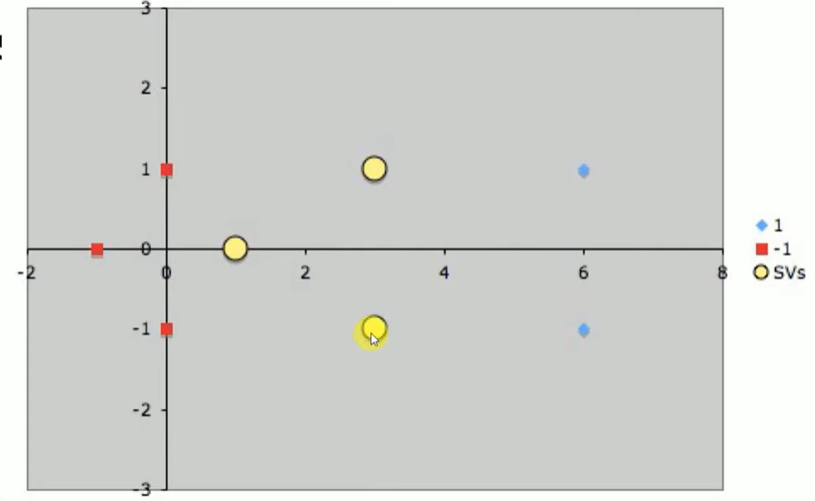

Slide 27
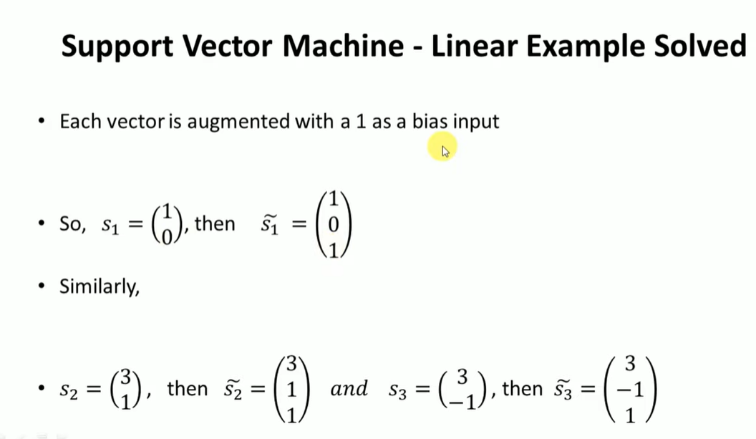

Slide 28
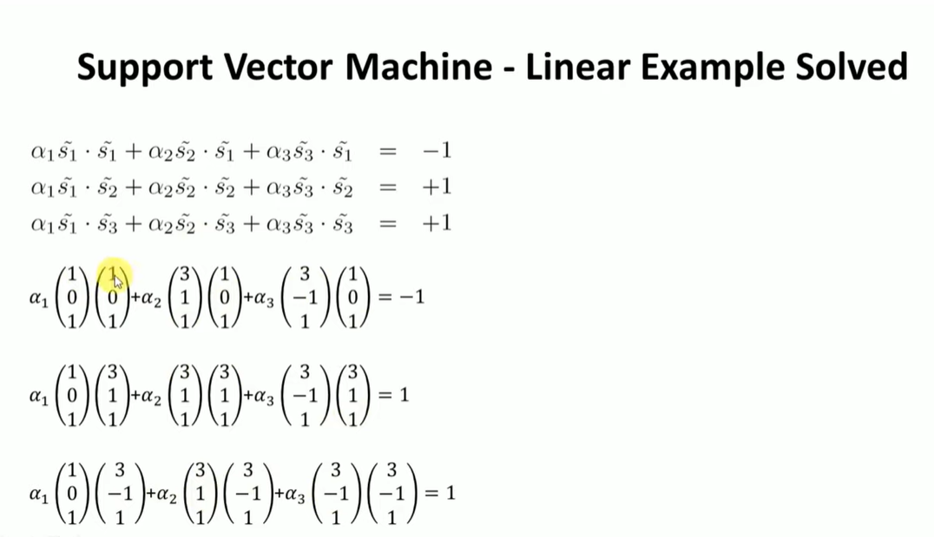

Slide 29
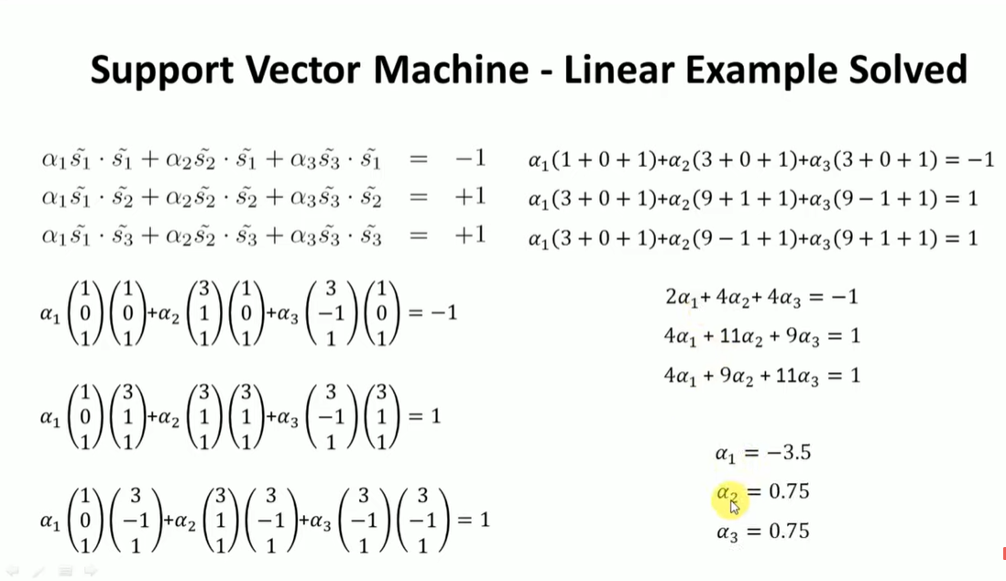

Slide 30
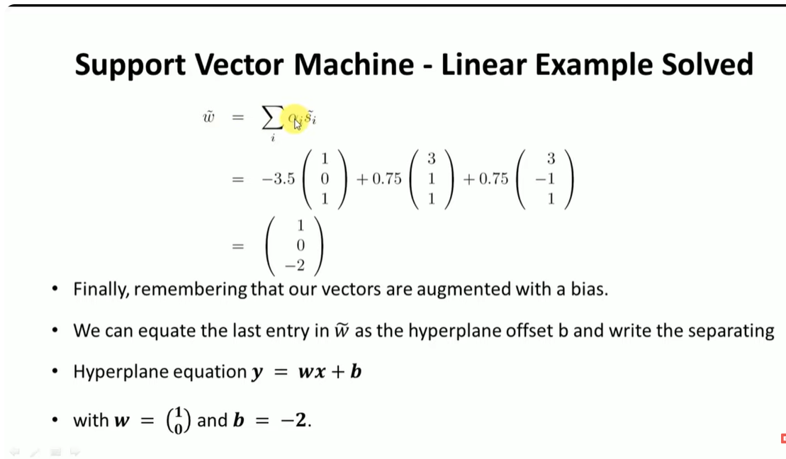

Slide 31
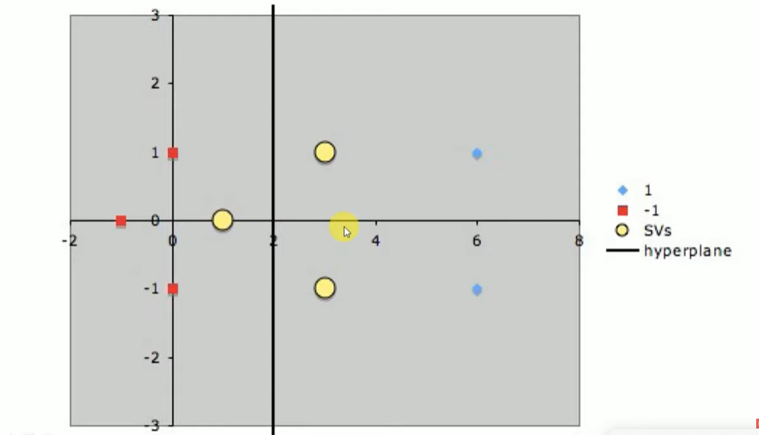

Slide 32
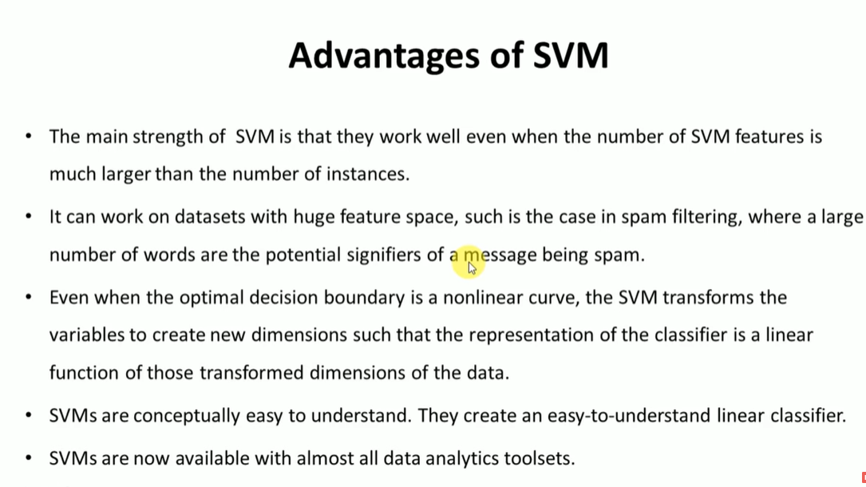

Slide 33
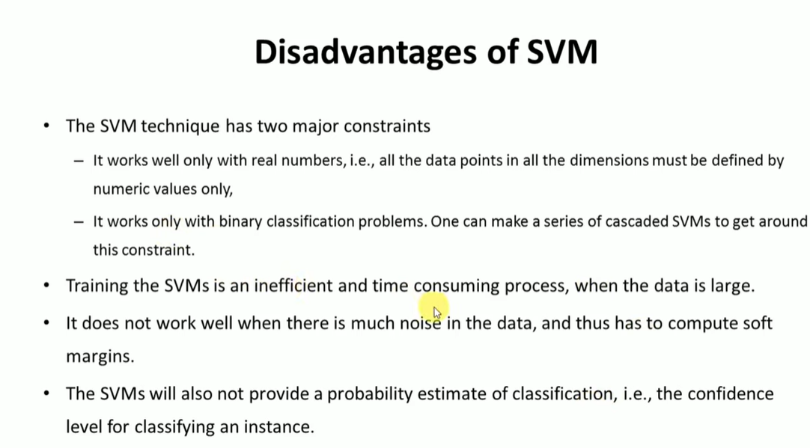

Slide 34
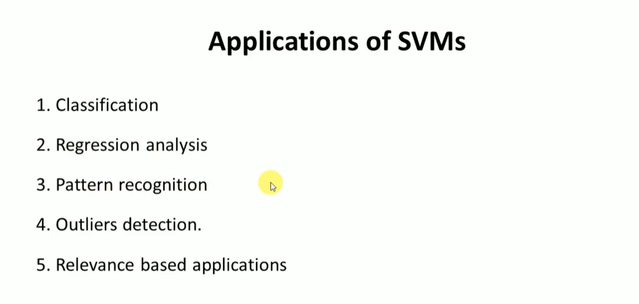

Slide 35
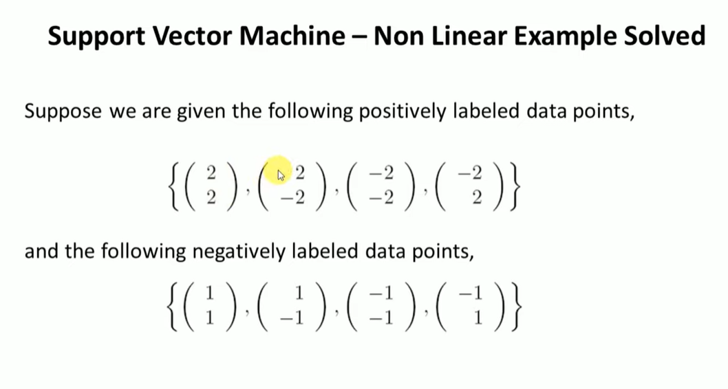

Slide 36
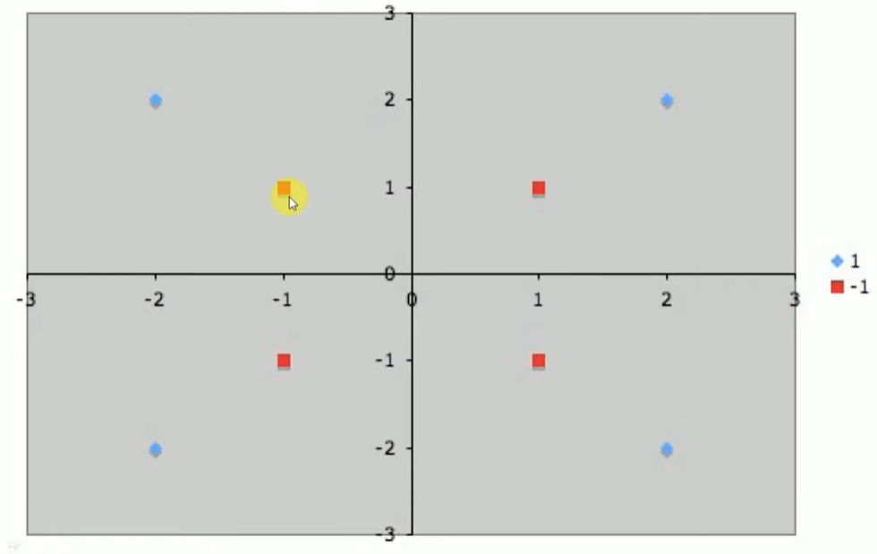

Slide 37
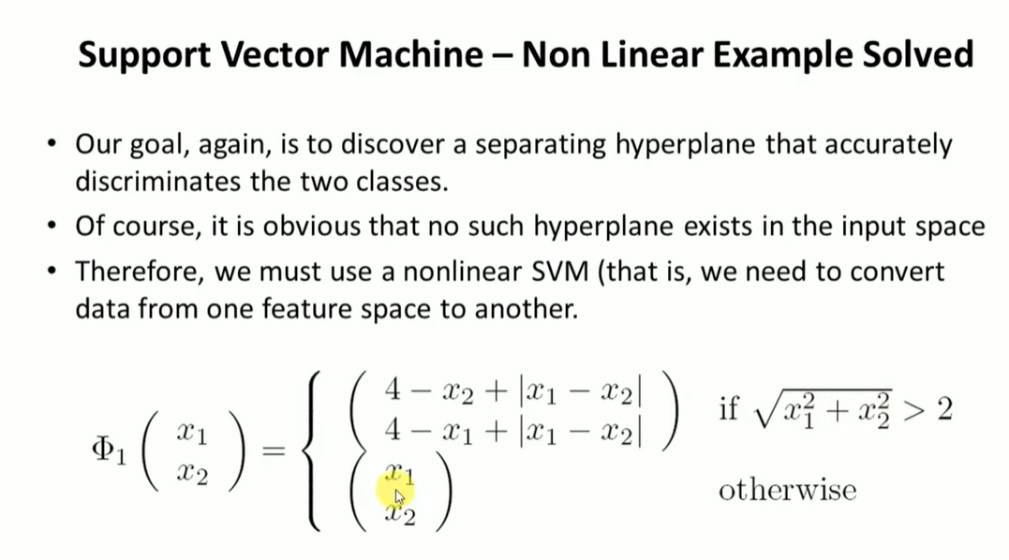

Slide 38
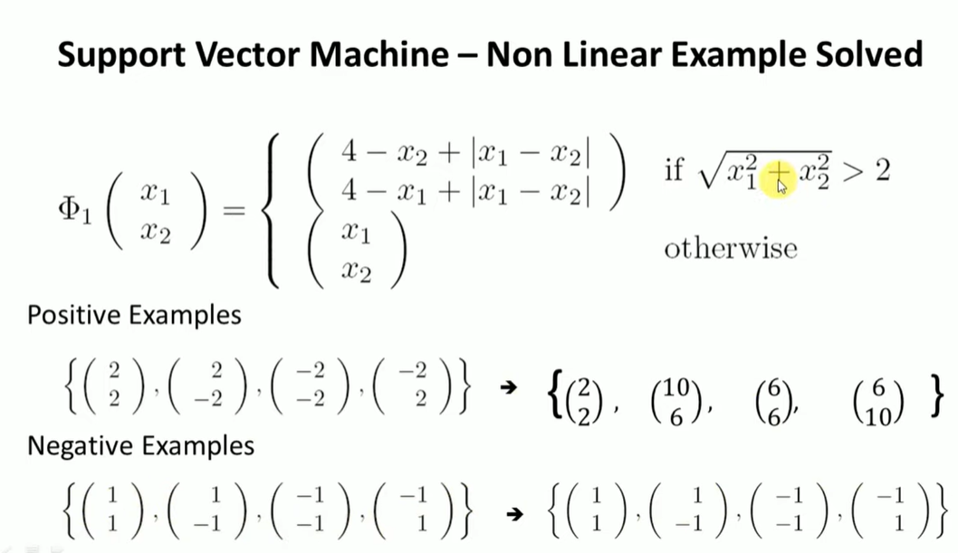

Slide 39
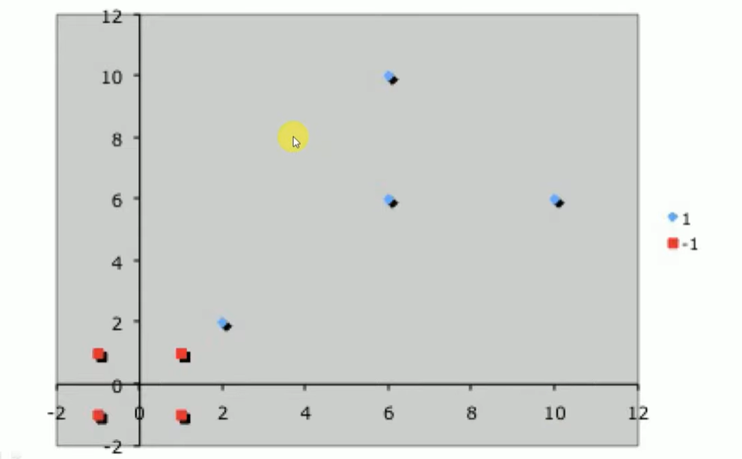

Slide 40
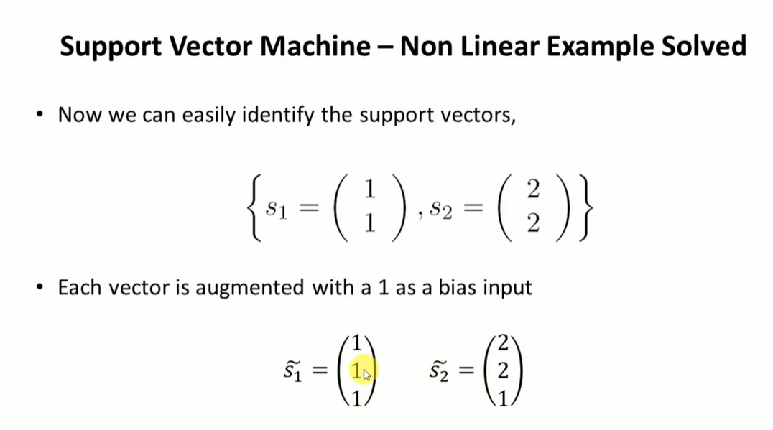

Slide 41
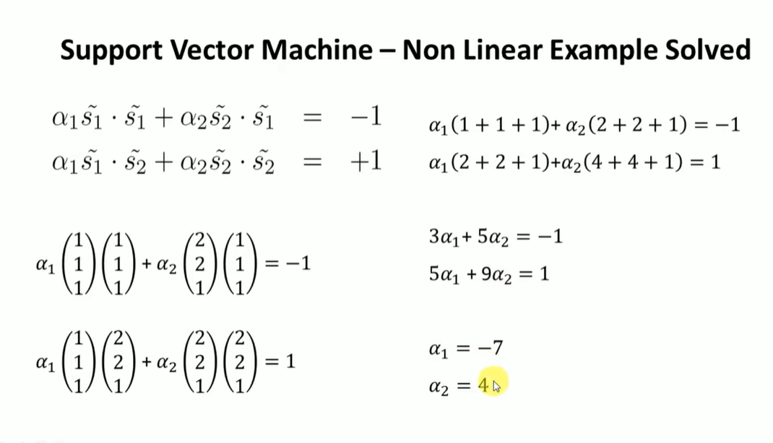

Slide 42
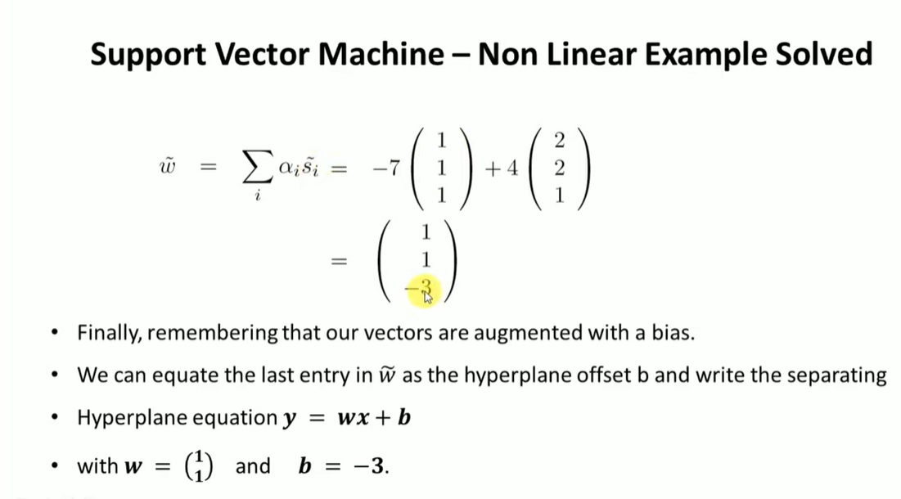

Slide 43
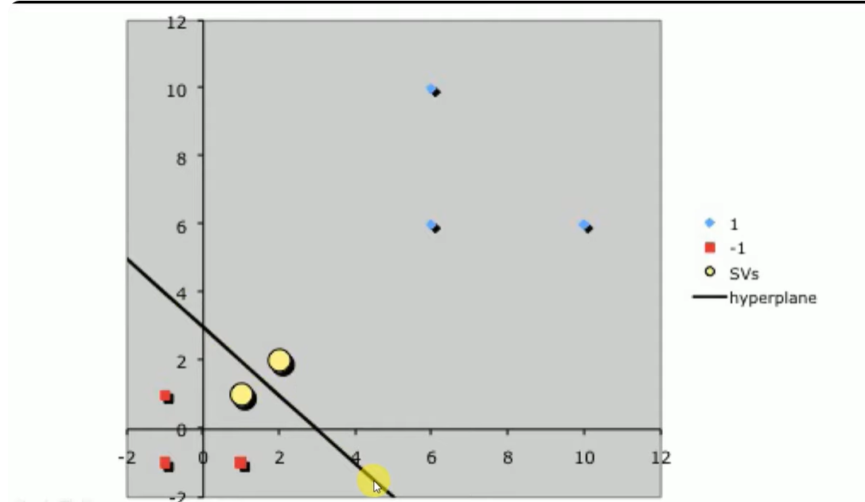

Slide 44
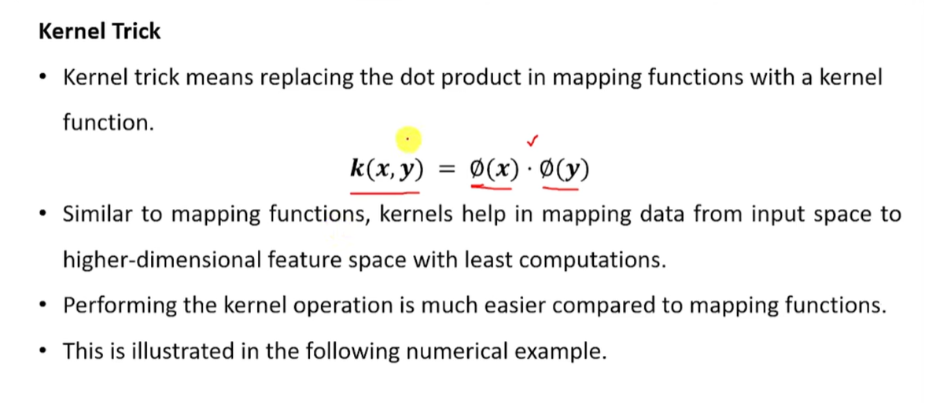

Slide 45
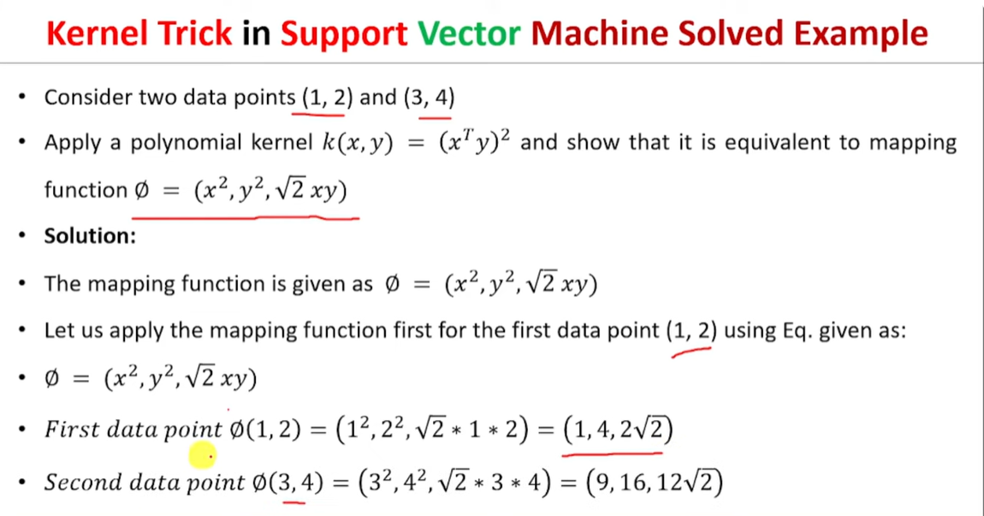

Slide 46
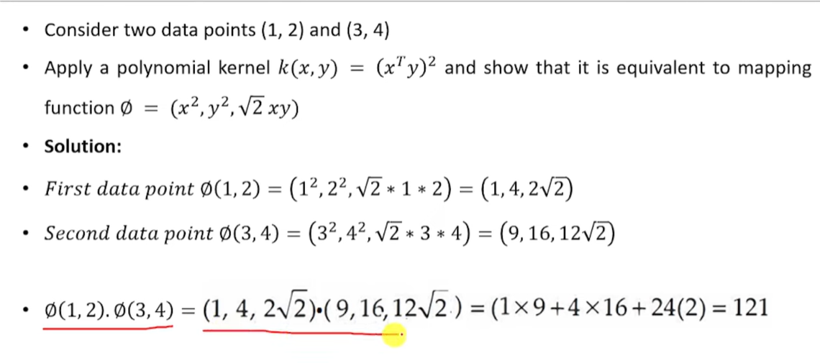

Slide 47
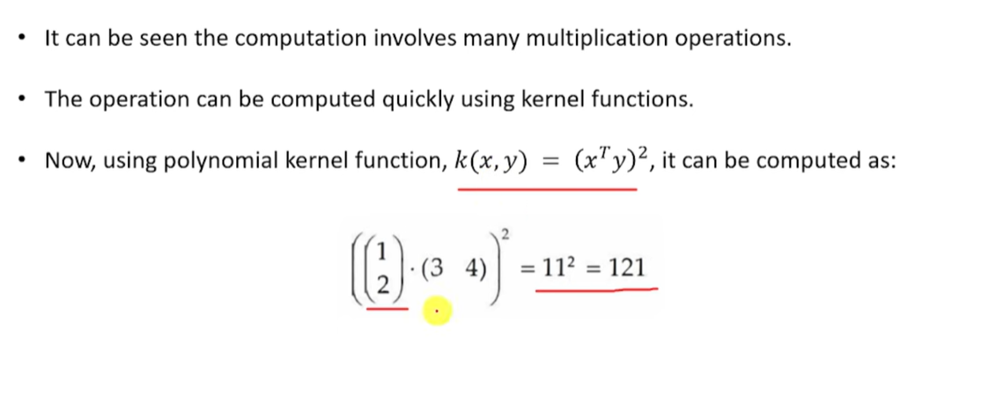

Slide 48
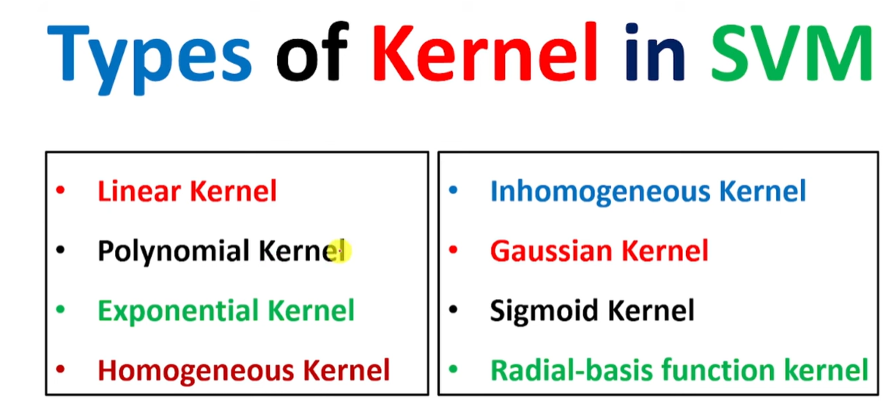

Slide 49
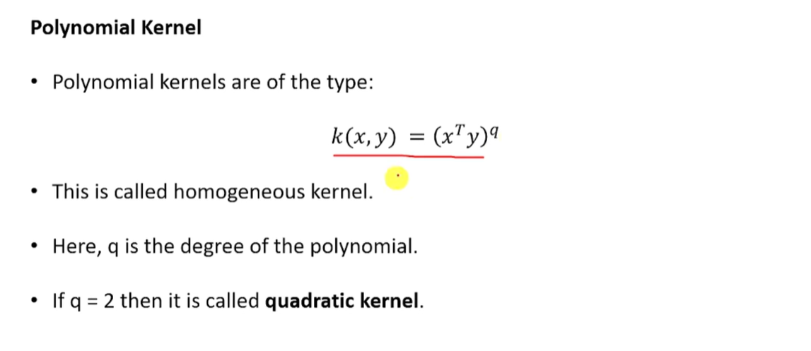

Slide 50
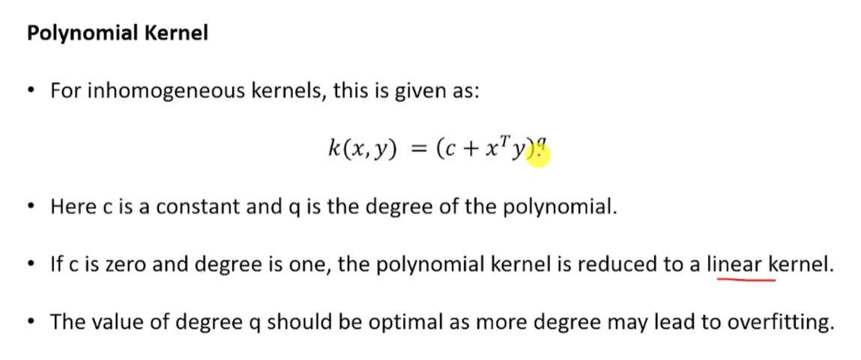

Slide 51
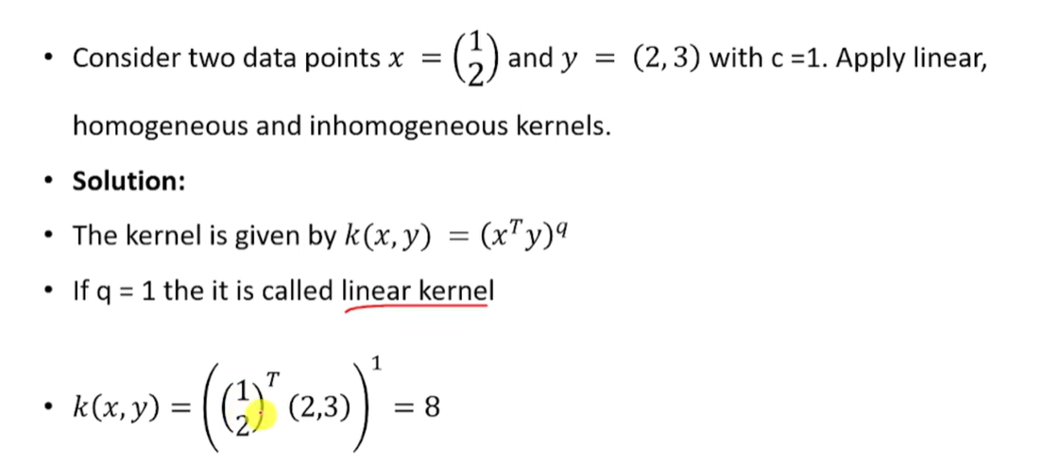

Slide 52
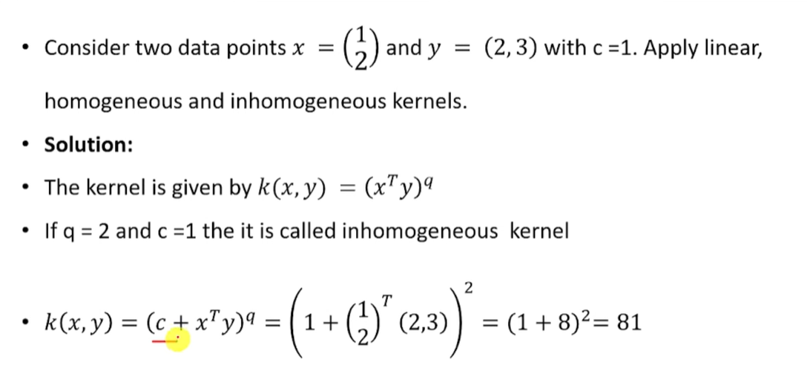

Slide 53
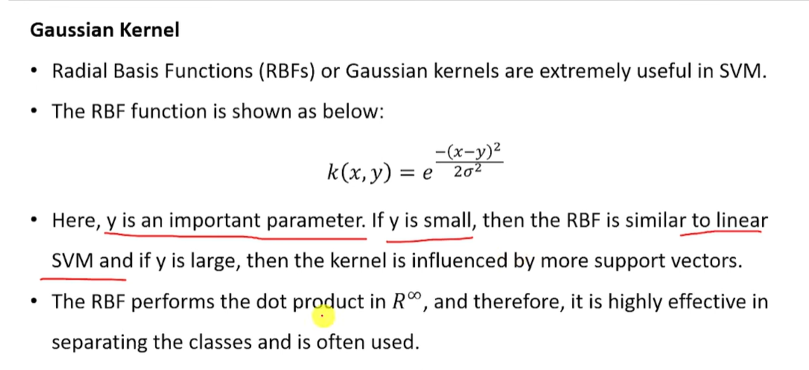

Slide 54
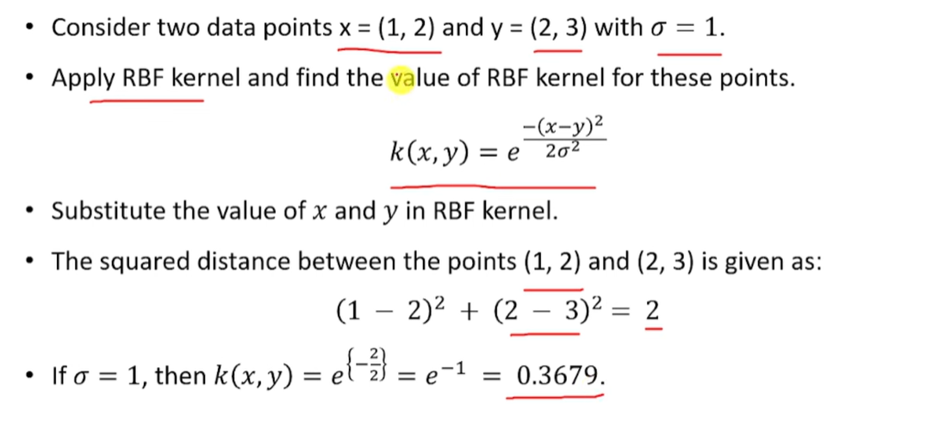

Slide 55
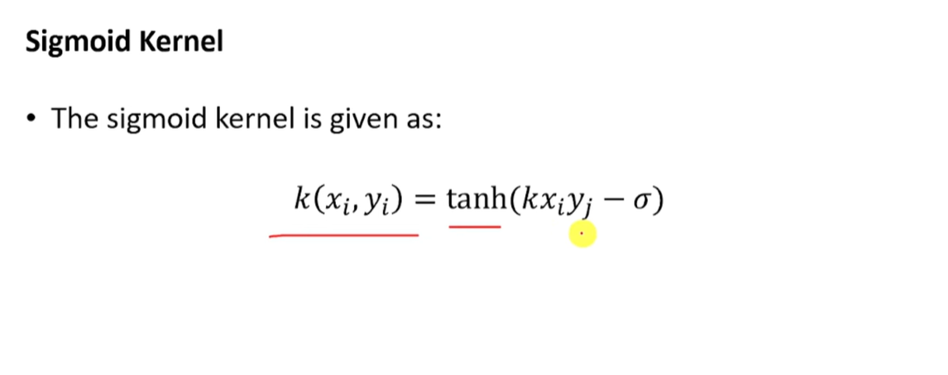

Slide 56
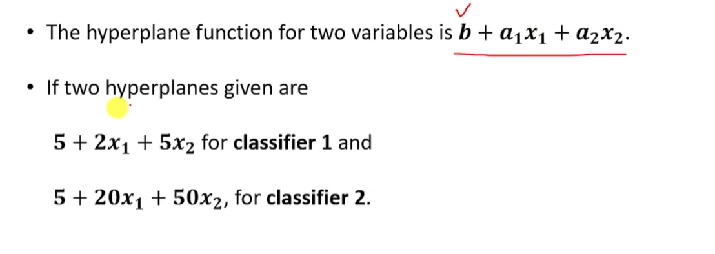

Slide 57
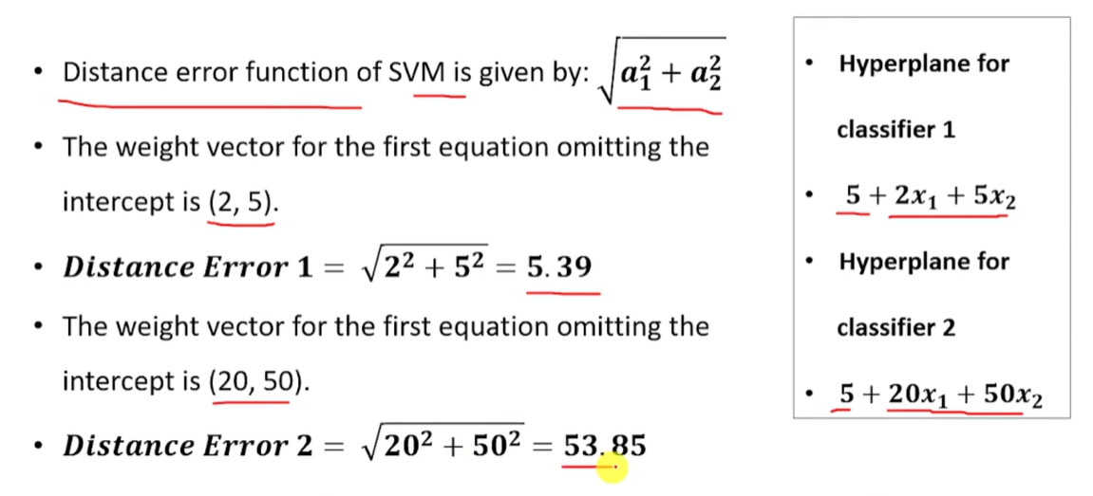

Slide 58


Slide 59
Soft Margin SVM
As C (Hinge Loss) increases tendency to make mistakes on training data leading to overfit
As C decreases tendency to underfit

Slide 60

Maximum Margin Classifier with Noise
Hard Margin: requires that all data points are classified correctly
What if the training set is noisy?
- Solution: use very powerful kernels
OVERFITTING!
Soft Margin Classification
Slack variables ε_{i} can be added to allow misclassification of difficult or noisy examples.
^{ε}11
ε₂ Minimize:
1
2
R
w.w + C∑″_{k}
k=1
wx+b=1
ε₇
wx+b=0
wx+b=-1

Slide 61
Hard Margin v.s. Soft Margin
The old formulation:
The new formulation incorporating slack variables:
Parameter C can be viewed as a way to control overfitting.
Find w and b such that
Φ(w) =½ w^{T}w is minimized and for all {(x_{i} ,y_{i})}
y_{i} (w^{T}x_{i} + b) ≥ 1
Find w and b such that
Φ(w) =½ w^{T}w + CΣε_{i} is minimized and for all {(x_{i} ,y_{i})}
y_{i} (w^{T}x_{i} + b) ≥ 1- ε_{i} and ε_{i} ≥ 0 for all i
Linear SVMs: Overview
The classifier is a separating hyperplane.
Most “important” training points are support vectors; they define the hyperplane.
Quadratic optimization algorithms can identify which training points x_{i} are support vectors with non-zero Lagrangian multipliers.
Both in the dual formulation of the problem and in the solution training points appear only inside dot products

Slide 62

Non-linear SVMs
Linearly separable data:
0
x
Map data to a
higher-dimensional space:
_{x}2
0
x
x
0
Non-linear SVMs: Feature spaces
Φ: x → φ(x)
The original input space can always be mapped to some higher-dimensional feature space where the training set is separable:

Slide 63
Kernels
The linear classifier relies on dot product between vectors K(x_{i},x_{j})=x_{i}^{T}x_{j}
If every data point is mapped into high-dimensional space via some transformation Φ: x → φ(x), the dot product becomes:
K(x_{i},x_{j})= φ(x_{i}) ^{T}φ(x_{j})
A kernel function is some function that corresponds to an inner product in some expanded feature space.
Kernels
Linear: K(x_{i},x_{j})= x_{i} ^{T}x_{j}
Polynomial of power p: K(x_{i},x_{j})= (1+ x_{i} ^{T}x_{j})^{p}
Gaussian (radial-basis function network):
2
x_{i} − x_{j )} 2! ²
K (x_{i} , x_{j} ) = exp(−
Sigmoid: K(x_{i},x_{j})= tanh(β₀x_{i} ^{T}x_{j} + β₁)

Slide 64
Nonlinear SVM - Overview
SVM locates a separating hyperplane in the feature space and classifies points in that space
It does not need to represent the space explicitly, simply by defining a kernel function
The kernel function plays the role of the dot product in the feature space.
Properties of SVM
Flexibility in choosing a similarity function
Sparseness of solution when dealing with large data sets
  only support vectors are used to specify the separating hyperplane
Ability to handle large feature spaces
  complexity does not depend on the dimensionality of the feature space
Overfitting can be controlled by soft margin approach
Nice math property: a simple convex optimization problem which is guaranteed to converge to a single global solution
Feature Selection

Slide 65
SVM Applications
text (and hypertext) categorization
image classification
bioinformatics (Protein classification, Cancer classification)
hand-written character recognition Etc.
Multi-class SVM
SVM only considers two classes
For m-class classification problem:
SVM 1 learns “Output==1” vs “Output != 1”
SVM 2 learns “Output==2” vs “Output != 2”
:
SVM m learns “Output==m” vs “Output != m”
To predict the output for a new input, just predict with each SVM and find out which one puts the prediction the furthest into the positive region.

